Slide 1
Grocery Store Website *Frontend*
HTML + CSS

Slide 2
Table of contents
01
02
03
04
05
06
Basic Layout(Sections)
Header Section
Home Section
Categories/Features Section
Featured Brand Section
Best Practices

Slide 3
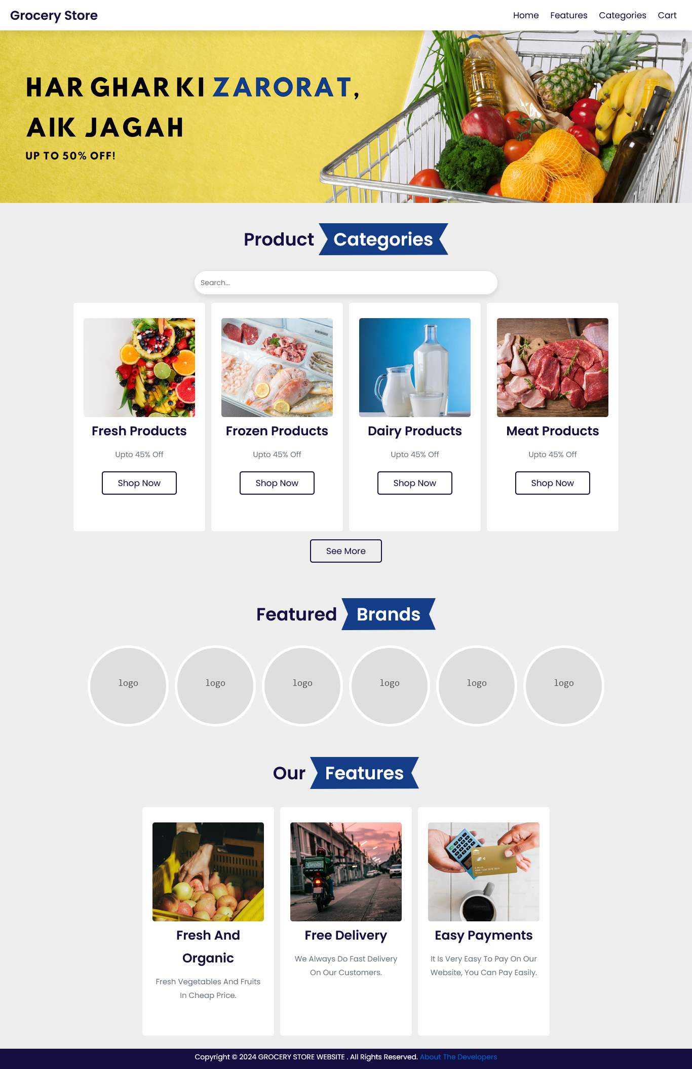

Slide 6

The Main layout of the website is made up of multiple <section> tags each with similar CSS

Slide 7
The Main layout of the website is made up of multiple <section> tags each with similar CSS

Slide 8
Navbar
Image Section
The Main layout of the website is made up of multiple <section> tags each with similar CSS
Categories
Section

Slide 10
The Navbar/Header consists of a logo(far right) and a <div>(far left), containing multiple <a> tags

Slide 11
The Navbar/Header consists of a logo(far right) and a <div>(far left), containing multiple <a> tags also in a <div>.

Slide 12
The Picture section does not contain any element, but the picture itself is applied as the background through CSS.

Slide 13
The Picture section does not contain any element. The picture itself is applied as the background through CSS.

Slide 14
The Categories and Features section have similar CSS and HTML.
Both <section> consist of multiple div boxes with “display:flex” property applied, helping to arrange the div boxes vertically

Slide 15
The Categories and Features section have similar CSS and HTML.
Both <section> consist of multiple div boxes with “display:flex” property applied, helping to arrange the div boxes vertically

Slide 16
The remaining brands and features section are also made on similar patterns with necessary changes.

Slide 17
The remaining brands and features section are also made on similar patterns with necessary changes.

Slide 22
These cards are also made using <div> tags with “display:flex” property applied. Moreover, the elements are also arranged vertically.

Slide 23
Thank You!
Any Questions?
Group Members:
Muhammad Ibrahim[24K-0649]
Muhammad Obaid Ullah[24K-0793]
Hasnain Siddiqui[24K-0516]

